Slide 1

Organization Development
Cdr Vijay Pratap Singh, Adjunct professor, E&TC, TCET

Slide 2


About Organization Development (OD)
Relatively new field of study – 50’s & 60’s
OD is about how organizations and people function and how to get them function better
Start Point – when the leader identifies an undesirable situation and seeks to change it.
Focus - Making organizations function better (total system change).
Orientation - Action (achieving results through planned activities).
No unifying theory – just models of practice
OD is an organization improvement strategy

Slide 3










Start Point
Poor alignment to organization’s strategy
Inappropriate organization structure
Low productivity
Poor quality
Poorly designed tasks
Poor morale
Organization
Intergroup conflict
Unclear goals
Poor team performance
Interpersonal conflicts
Inappropriate leadership style

Slide 4

Focus
Change – new state of things, different from old state of things
Can be viewed as an opportunity or as a threat
First order change
(making moderate adjustments)
Change
Second order change (reinvent, reengineer, rewrite)
What needs to be changed and how to go about it
OD consultants are experts in organizational change

Slide 5

Orientation
Diagnosing
This process is known as
‘Action Research’
Taking Action
Three ingredients:
3. Participation
5. OD consultant (as collaborator & colearner)
7. Iterative process of diagnosis & action
Re-Diagnosing
Taking New Action
Change occurs based on the actions taken
New knowledge comes from examining the results of the actions.

Slide 6
Definition(s) of OD
Organization Development is an effort (1) planned, (2) organization-wide, and (3) managed from top, to (4) increase organization effectiveness and health through (5) planned interventions in organization’s “processes”, using behavioral-
science knowledge.
…Beckhard, 1969
Organization Development is a process of planned change – change of an organization’s culture from one which avoids an examination of social processes (especially decision making, planning and communication) to one which
institutionalizes and legitimizes this examination.
…Burke & Hornstein, 1972
Organization Development is a systematic application of behavioral science knowledge to the planned development and reinforcement of organizational strategies, structures, and processes for improving an organization’s effectiveness.
…Cummings & Worley, 1993
Organization development is a planned process of change in an organization’s culture through the utilization of behavioral science technologies, research, and
theory.
…Burke, 1994

Slide 7
History of OD
T-group
Survey Feedback Technology
Action research
Sociotechnical & Socioclinical approaches
Four major stems of OD
T-Group (Laboratory Training) – participants learn from their own actions and the group’s evolving dynamics
Developing reliable questionnaires, collecting data from personnel, analyzing it for trends, and feeding the results back to everyone for action planning
Diagnosing, taking action, re-diagnosing and taking new action
Integrate social requirements of employees with technical requirements needed to do work in provided environment.

Slide 8
Revolutionary Values & Beliefs of OD
Organic systems (mutual confidence & trust) rather than mechanical systems
(authority-obedience)
…. Warren Bennis
Basic units of change are groups, not individuals
…. Richard Beckhard
Away from resisting and fearing individual differences towards accepting and
utilizing them
…. Robert Tannenbaum
Trust and respect for individual Open communication Decentralized decision making Collaboration and cooperation Appropriate use of powers
Authentic interpersonal relationships
Radical departure from accepted values and beliefs of 1960’s

Slide 9
Second-Generation OD
Organization Transformation
Organizational Culture
Learning Organization
Total Quality Management
Visioning and Future Search Business Process
Reengineering Quality of Work Life

Slide 10
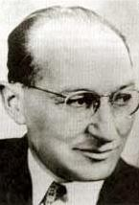
Models and theories
Change is a three-stage process
Stage 1- Unfreezing the old behavior/ situation Stage 2 - Moving to a new level of behaviors Stage 3 - Refreezing the behavior at the new level
Kurt Lewin
Edgar Schein modified this theory by specifying psychological mechanisms involved in each stage
Later Ronald Lippitt, Jeanne Watson and Bruce Westley expanded this model into seven-stage model

Slide 11
Models and theories Contd..
Seven stage model representing the consulting process
Phase 1
Developing a need for change.
Phase 2
Establishing the change relationship.
Phase 3
Diagnosing the client system’s problem.
Examining alternative routes, establishing goals and intentions of action.
Transforming intentions into actual change efforts.
Phase 4
Phase 5
Phase 6
Stabilizing change.
Phase 7
Achieving a terminal relationship.

Slide 12
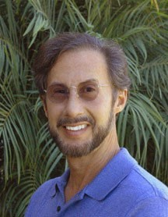



Models and theories Contd..
1. The culture track
3. The management skills track
5. The team-building track
7. The strategy-structure track
9. The reward system track
Ralph Kilmann
Five points
critical leverage
(tracks) for
organization change
Track 1 : Enhances trust, communication, information sharing Track 2 : Provide new ways of coping with complex problems Track 3 : Infuses new culture and updated management skills Track 4 : Develops revised strategy plan for organization Track 5 : Establishes performance based reward system
AT&T, Eastman Kodak, Ford, General Electric, Xerox etc.

Slide 13
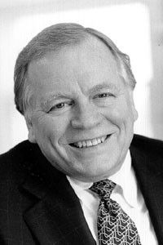
Models and theories Contd..
The Burke-Litwin Model of Organizational Change
Warner Burke
First order change (Transactional change)
Change
Second order change (Transformational change)
OD interventions directed towards structure, management practices, and systems (policies & procedures) result in first order change.
OD interventions directed towards mission and strategy, leadership, and organization culture result in second order change.

Slide 14
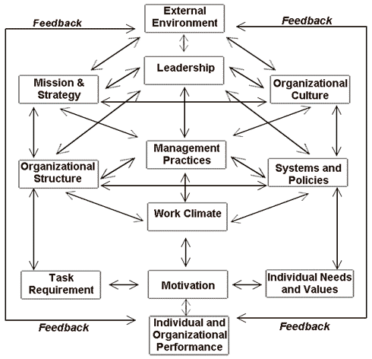
Models and theories Contd..
Transformational factors
Transactional factors

Slide 15
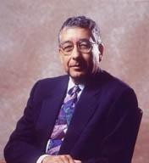
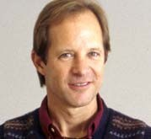


Models and theories Contd..
Porras & Robertson Model of Organizational Change
Jerry Porras Peter Robertson
OD interventions alter features of the work setting causing changes in individuals’ behaviors, which in turn lead to individual and organizational improvements.
Organizing arrangements Social factors
Physical setting Technology
1
2
Work setting factors
3
4

Slide 16
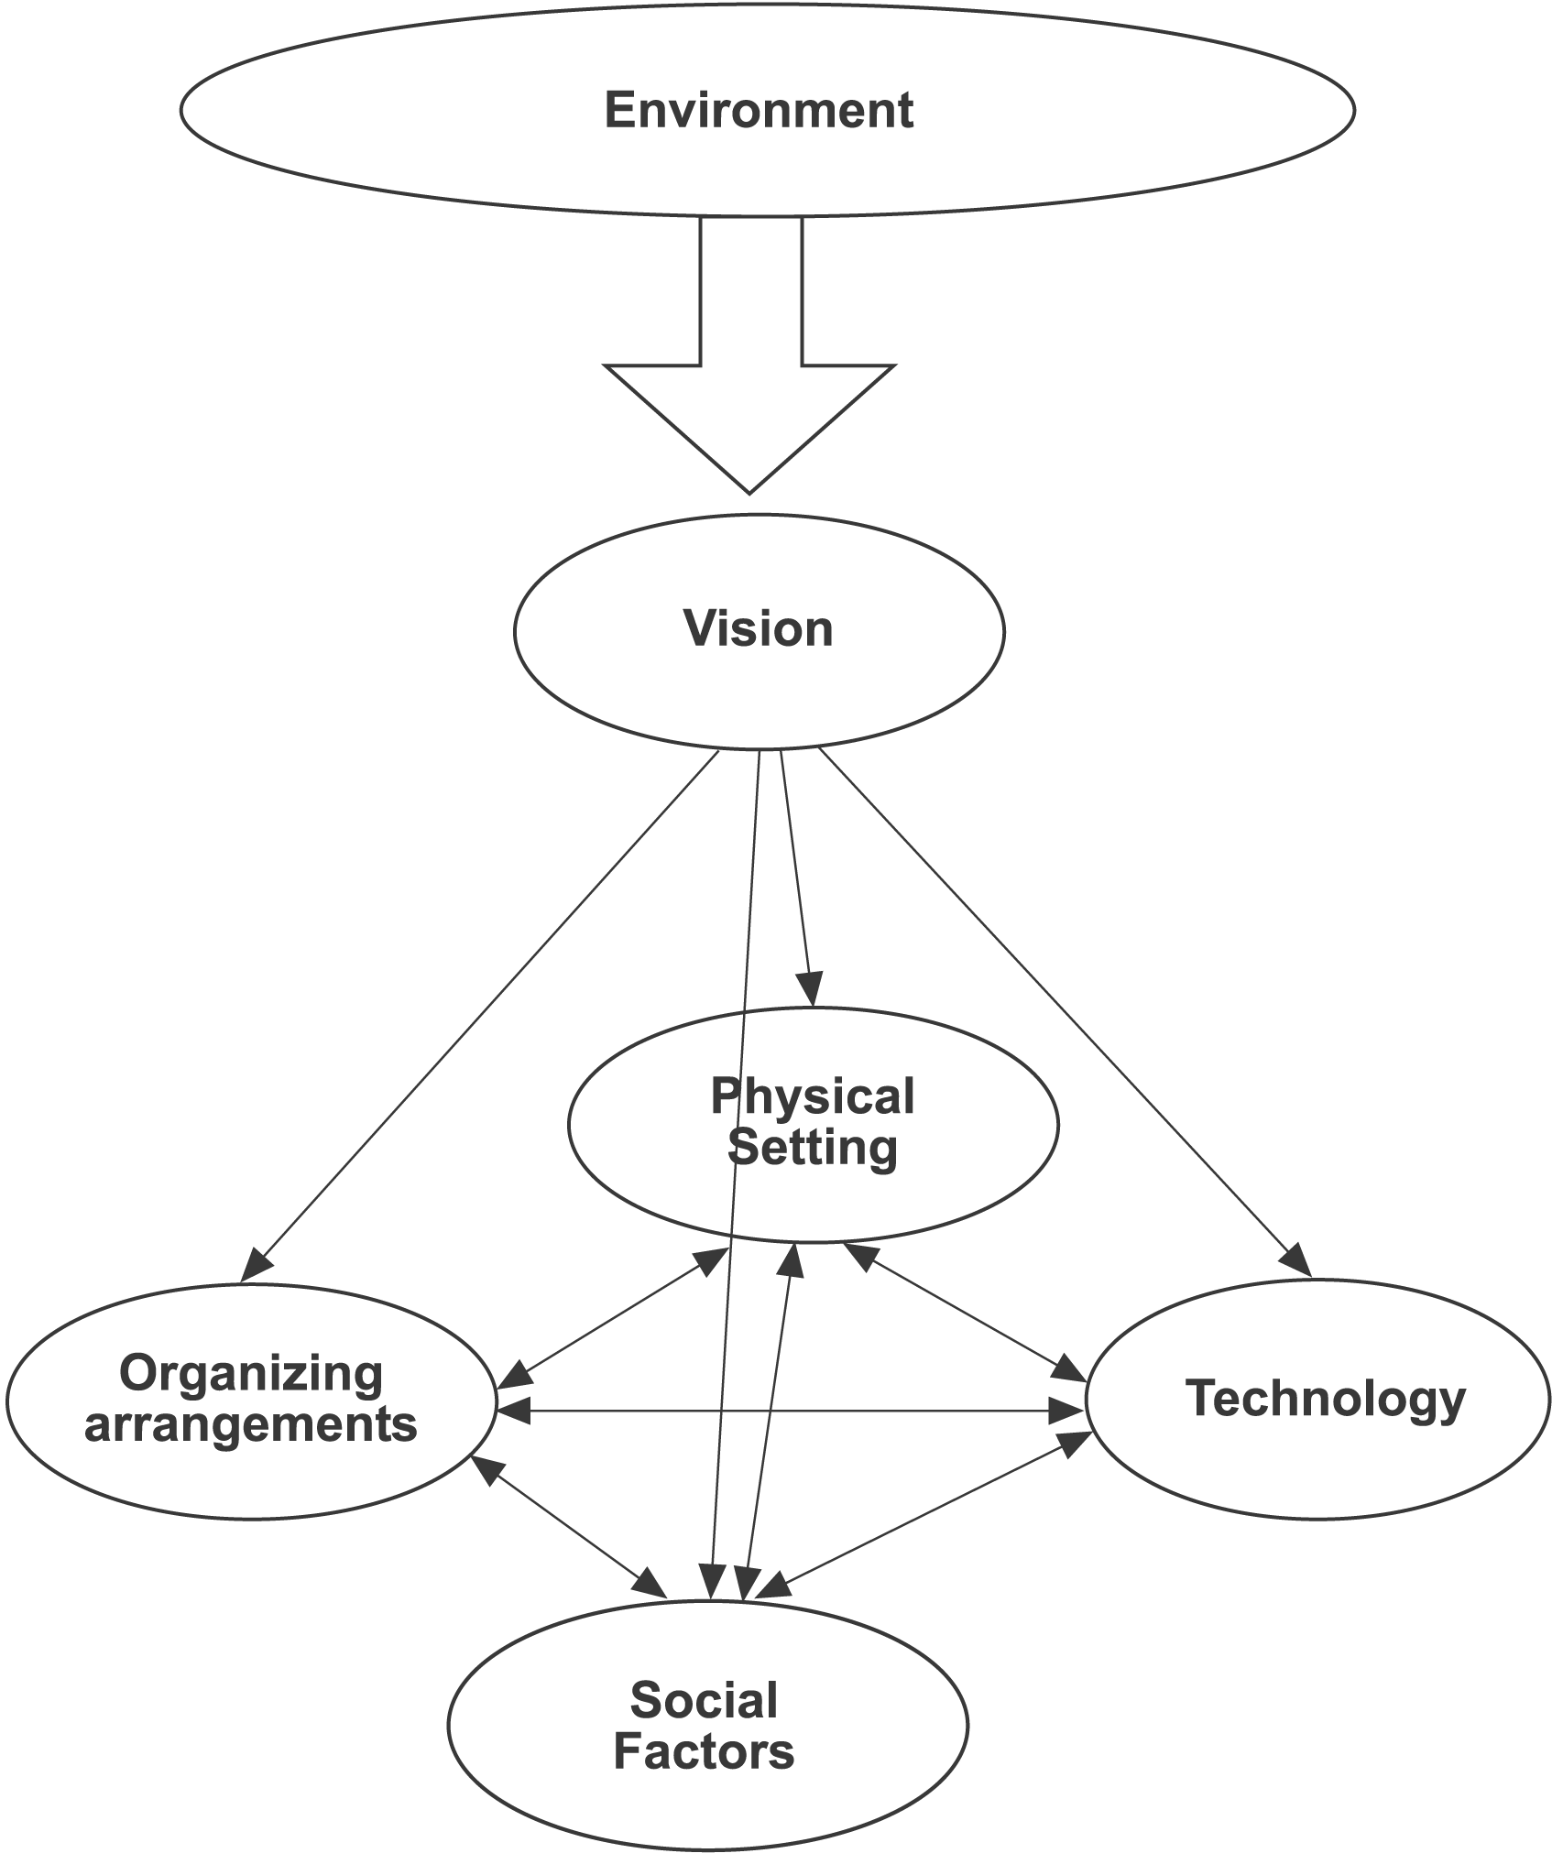
Models and theories Contd..
Organizing arrangements Goals, strategies, structure, policies, procedures
Social Factors
Culture, management style, informal networks, individual attributes
Physical Settings
Space configuration, physical ambiance
Technology Machinery, tools, IT, job design

Slide 17
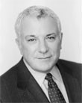
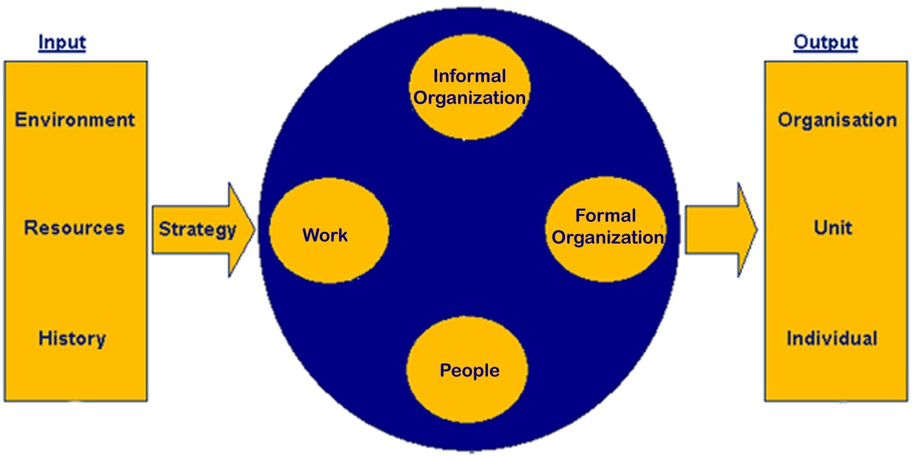
Systems Theory
Organizations are open systems in active exchange with their environment
David A. Nadler
The Congruence Model

Slide 18
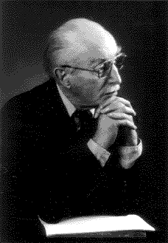
Systems Theory Contd..
Sociotechnical Systems Theory (STS)
All organizations comprised of two interdependent systems:
Social system
Technical system
Eric Trist
To achieve high productivity and employee satisfaction, organizations must optimize both systems.
Changes in one system affect the other system.

Slide 19

Participation & Empowerment
Participation in OD programs is not restricted to elites or top people; it is extended broadly throughout the organization.
Increased participation and empowerment have always been central goals and fundamental values of OD.
Participation enhances empowerment and empowerment in turn enhances performance.
Empowerment is the key to getting people to want to participate in change.

Slide 20

Teams & Teamwork
Many tasks are so complex that they cannot be performed by individuals; people must work together to accomplish them.
Characteristics of successful teams
3.clear, elevating goal
5.result driven structure
7.competent members 9.unified commitment 11.collaborative climate 13.standards of excellence
15.external support and recognition
17.principled leadership
…..Larson & LaFasto
Putting those empowered individuals into teams creates extraordinary effects on performance.
Teams create synergy i.e. sum of efforts of team is far greater than sum of individual efforts.
A number of OD interventions are
specifically designed to improve team
performance. Examples – team building, quality circles etc.

Slide 21
Parallel Learning Structures
A parallel learning structure consists of a steering committee and a number of working groups* that study what changes are needed, make recommendations of improvements, and monitor the change efforts.
(* Idea groups, action groups, implementation groups etc.)
One or more top executive should be part of steering committee
Representatives from all parts of the organization
In large bureaucratic organizations :
Inhibit : learning Innovation Change
High forces of inertia
Hierarchical communication pattern
Standard ways of addressing problems
Here parallel learning structures are best way to initiate change

Slide 22
Normative-Reeducative Strategy of Change
Norms form the basis for behavior, and change comes through reeducation in which old norms are discarded and replaced by new ones.
Changes in normative orientations involve changes in:
Attitudes
Values
Skills
Relationships
Norms can be best changed by focusing on the individual.
group, not the

Slide 23




Applied Behavioral Science
OD is an application of behavioral science
Pure/ Basic Science
Generating knowledge
Applied Science Knowledge to Solve practical problems
Practice Theory : Diagnosing the situation, then selecting and implementing treatments based on diagnosis, and finally evaluating the effects of the treatments.
Practice Research Practice Theory
Applied Science
What helps me solve this problem?
Applied Behavioral Science
What helps me solve real problems?
Behavioral Science Research Behavioral Science Theory
Pure/ basic science

Slide 24
Action Research
Data Collection
Feedback of data to client system members
Diagnostic Participant Empirical Experimental
Action planning based on the data Taking action
Evaluating results of actions
Types
Diagnostic
Researcher enters a problem situation, diagnoses it and make recommendations for remedial treatment (recommendations may not be put into effect by client group)
People who are to take action are involved in the entire process
from the beginning (involvement increases the likelihood of carrying out the actions once decided upon)
Participant
Empirical
Researcher keeps the systematic, extensive record of what he/ she did and what effects it had (may encounter situations too divergent from one another, which may not permit generalizations)
It is controlled research on the relative effectiveness of various techniques (is difficult to do when client wants immediate
answers)
Experimental

Slide 25

Managing the OD Process
Three basic components of OD programs:
Diagnosis | Continuous collection of data about total system, its subunits, its processes, and its culture
Action | All activities and interventions designed to improve the organization’s functioning
Program management | All activities designed to ensure success of the program

Slide 26
Diagnosing Organizational Subsystems
Diagnostic targets | Information sought | Methods of Diagnosis
The total organization | Q) What is organization’s culture? Q) Are organizational goals and strategy understood and accepted? Q) What is organization’s performance? | Examination of organizational records – rules, regulations, policies Questionnaire survey Interviews (both group & individual)
Large and complex subsystems | Q) What are the unique demands on this subsystem? Q) Are organization structures and processes related to unique demands? Q) What are the major problems confronting this subsystem? | Questionnaire survey Interviews Observations Organization records
Small and simple subsystem | Q) What are major problems of the team? Q) How can team effectiveness be improved? Q) Do individuals know how their jobs relate to organizational goals? | Individual interviews group meeting to review the interview data Questionnaires Observation of staff meetings and other day- to-day operations
Intergroup subsystems | Q) How does each subsystem see the other? Q) What problems do the two groups have in working together? Q) How can they collaborate to improve performance of both groups? | Interviews of each subsystem followed by ‘sharing the data meeting’ Flowcharting critical processes Meetings between both groups
Individuals | Q) Do people perform according to organization’s expectations? Q) Do they need particular knowledge or skills? Q) What career development opportunities do they have/ want/ need? | Interviews Information from diagnostic meetings Data available with HR department
Roles | Q) Is the role defines adequately? Q) What is the ‘fit’ between person and role? Q) Is this the right person for this role? | Role analysis Observations Interviews

Slide 27
Diagnosing Organizational Processes
Organizational Processes | Information sought | Methods of Diagnosis
Communication patterns, styles & flows | Q) Is communication open or closed? Q) Is communication directed upward, downward, laterally? Q) Are communications filtered? ….. Why? How? | Observations – in meetings Questionnaires Interviews and discussion with group members
Goal setting | Q) Do people set goals? Q) Who participates? Q) Do they possess necessary skills for effective goal setting? | Questionnaires Interviews Observations
Decision making, problem solving & action planning | Q) Who makes decisions? Q) Are they effective? Q) Are additional decision making skills needed? | Observations of problem-solving meetings Analysis of videotaped sessions Organizational records
Conflict resolution and management | Q) Where does conflict exist? Q) Who are involved parties? Q) How is it being managed? | Interviews Flowcharting critical processes Meetings between both groups
Superior-subordinate relations | Q) What are the prevailing leadership styles? Q) What problems arise between superiors and subordinates? | Questionnaires Interviews
Strategic management & long range planning | Q) Who is responsible for ‘looking ahead’ and making long term decisions? Q) Do they have adequate tools and support? Q) Have the recent long range decisions been effective? | Interviews of key policy makers Group discussions Examination of historical records

Slide 28
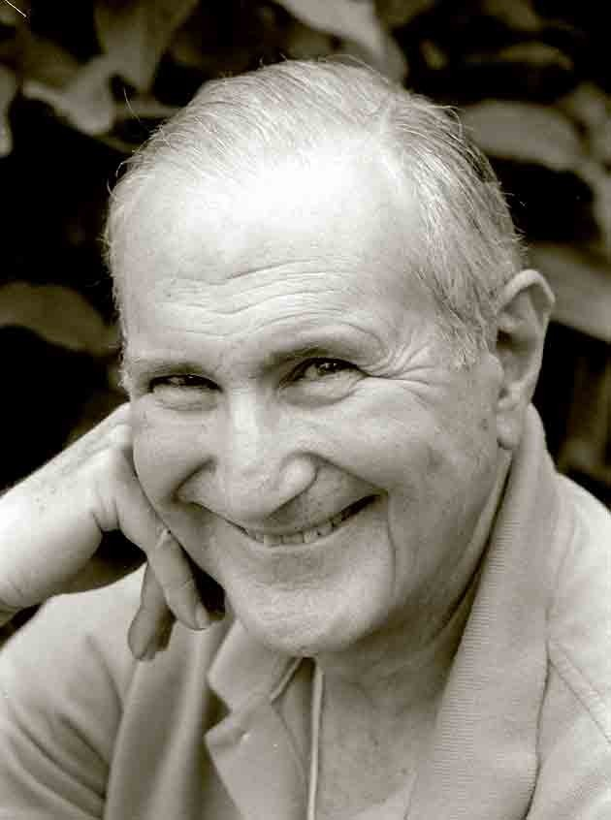
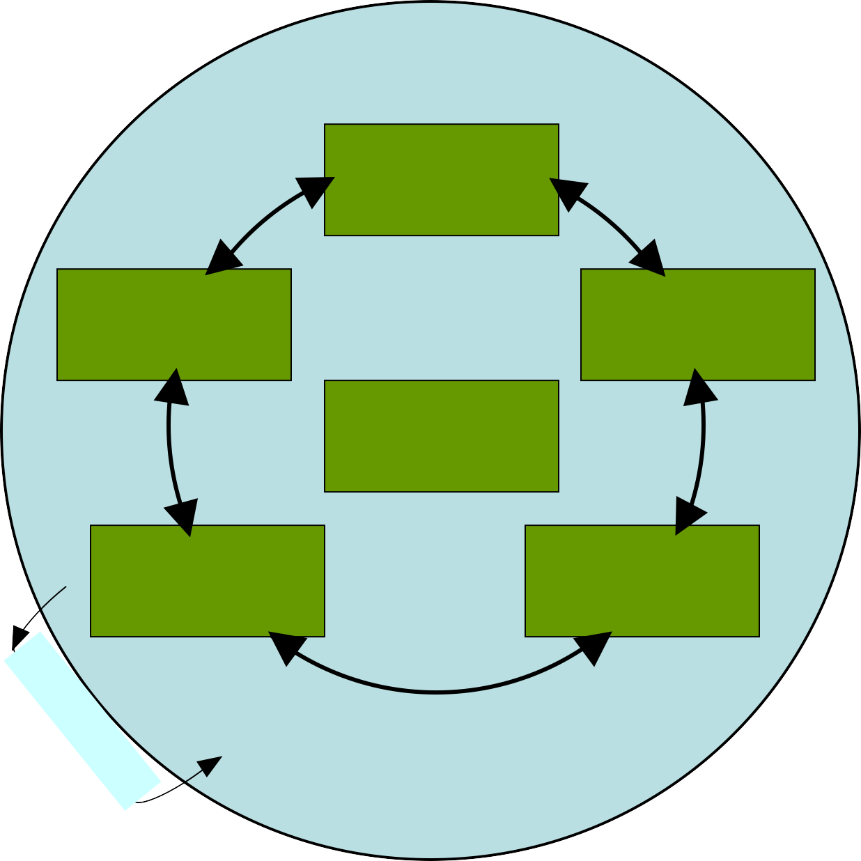
Diagnosis – The Six-Box Model
Purposes
Marvin Weisbord
Weisbord identifies six critical areas where things must go right if organisation is to be successful. According to him, the consultant
Relationships
Structure
Leadership
must attend to both formal and informal
Helpful Mechanisms
Rewards
aspects of each box.
This model is still widely used by OD practitioners
Environment

Slide 29
Actions
Interventions are the actions taken to produce desired changes. Four conditions that give rise to the need for OD interventions:
The organisation has a problem (corrective action – to fix it)
Organization sees an unrealized opportunity (enabling action – to seize the opportunity)
Features of organization are out of alignment (alignment action – to get things back ‘in sync’)
Yesterday’s vision is no longer good enough
(action for new vision – actions to build necessary structures, processes and culture to make new vision a reality)

Slide 30

Interventions
Major families of OD interventions:
Diagnostic
Team-Building
Intergroup
Education and Training
Structural
Process Consultation
Grid Organization Development
Third-Party Peace Making
Coaching and Counseling 10.Life and Career Planning 11.Planning and Goal Setting 12.Strategic Management
Each of these families of interventions includes many activities

Slide 32
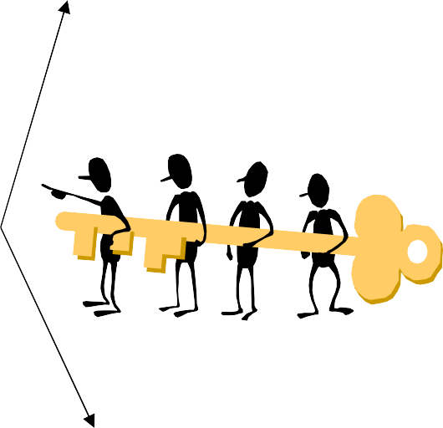
Example : Team Building Interventions
Diagnostic meetings
Team building focused on goal setting, decision making, problem
Intact work teams
solving etc.
Building & mainitaining effective interpersonal relationships
Role analysis techniques for role clarification & defination
Team building interventions
Team building focused on task accomplishment
Task allocations Interunit conflicts Role negotiation
Special teams

Slide 33
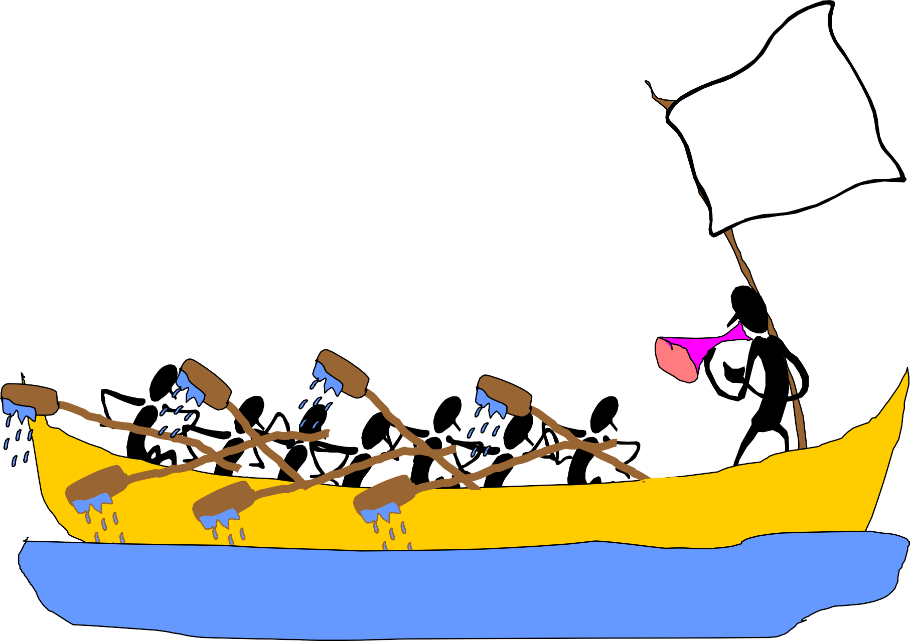

Slide 34
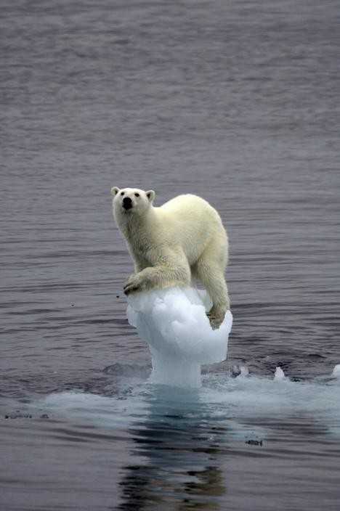
Program Management
Cummings and Worley identified 5 sets of activities required for effective change management:
Motivating Change
Creating a Vision
Effective Change Management
Developing Political Support
Managing the Transition
Sustaining Momentum

Slide 35
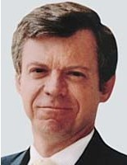


Program Management Contd..
Kotter’s 8-stage process for managing organizational change:
1
Establishing a sense of urgency
2
Creating a guiding coalition
HBR, Mar-Apr 1995, p.61
3
Developing a vision and strategy
Communicating the change vision
John P. Kotter
4
5
Empowering a broad base of people to take action
6
Generating short term wins
7
Consolidating gains and producing even more change
Anchoring (institutionalizing) the new approaches into the culture
8

Slide 36





Summary
OD can make a difference
Good understanding Proper response Adaptability

Slide 37











www.odnetwork.org
An international association of professionals engaged in work that makes organizations healthier and more effective
http://www.buzzle.com/editorials/9-13-2006-108634.asp
How much do you know about the effects of organizational development on the people affected by the change?
http://www.orkut.co.in/Main#Community.aspx?cmm=55127430

Slide 38


